Slide 1
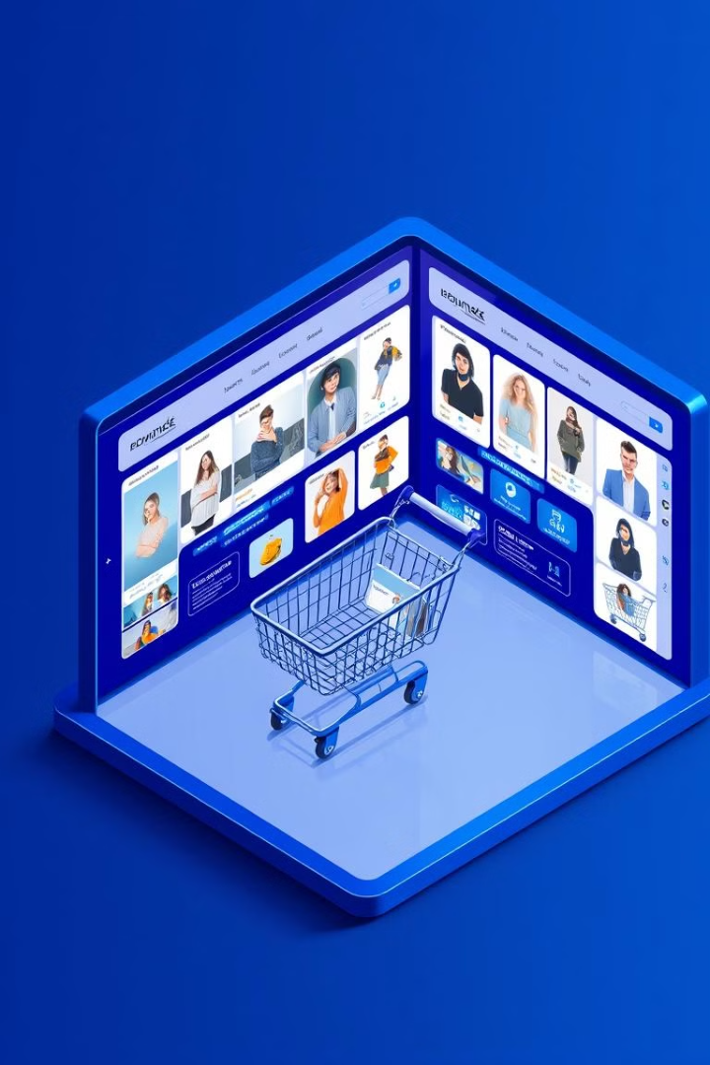
SHOP EZ - E-commerce Application using MERN Stack
Welcome to the presentation of SHOP EZ, a comprehensive e-commerce platform built using the MERN stack. This project offers a seamless online shopping experience with user-friendly features and a robust backend infrastructure.
NM Team ID : NM2024TMID09662
GitHub - hruday377363/SHOP_EZ-Nan-Mudhalvan
Team Register number
A R HRUDAYABHIRAM 211521243019
JAIGANESH V 211521243069
HARIKRISHNAMOORTHY M 211521243061
MUHILAN K B 211521243103

Slide 2

Abstract
SHOP EZ is a fully functional e-commerce platform developed using the MERN stack, designed to provide a seamless and user-friendly online shopping experience.
It enables users to browse products, make secure payments, track orders, and interact with a custom-built admin dashboard to manage products, users, and orders.
Seamless Experience
Secure Transactions
Powerful Administration
Provides a user-friendly interface for online shopping.
Enables secure online payments and order tracking.
Offers a custom dashboard for managing products, users, and orders.

Slide 3
Introduction
In the digital age, e-commerce has become a significant part of daily life.
Traditional e-commerce platforms often struggle with scalability, security, and maintenance. SHOP EZ seeks to address these issues by providing a modern e-commerce solution with a dynamic, scalable architecture using the MERN stack (MongoDB, Express, React, and Node.js).
Scalability
Security
Maintenance
The MERN stack allows for a dynamic and scalable architecture.
The platform incorporates strong security measures to protect data and transactions.
The MERN stack offers a more efficient and maintainable solution.

Slide 4
Existing System
Existing e-commerce platforms often struggle with scalability, security, and maintenance. SHOP EZ seeks to address these issues by providing a modern e-commerce solution with a dynamic, scalable architecture using the MERN stack (MongoDB, Express, React, and Node.js).
Monolithic Architectures
Limited Customization
High Maintenance and Costs
Existing platforms often use monolithic architecture, making them challenging to scale and maintain.
Most platforms offer limited customization options, restricting businesses from tailoring the website to their specific needs.
Traditional platforms require constant updates and maintenance, making them costly.
Security Vulnerabilities
Lack of Real-Time Features
Data privacy and transaction security are often weak points in many platforms.
Existing systems may lack real-time features like order tracking, product updates, or chatbots for customer service.

Slide 5
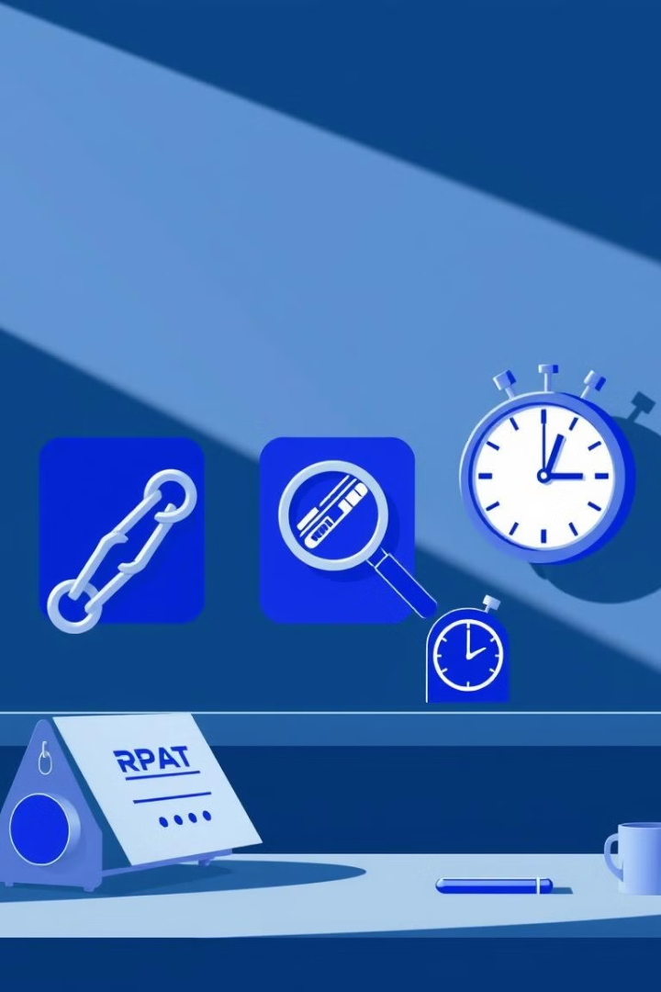




Drawbacks
The drawbacks of traditional e-commerce systems include: Complexity and Cost: High licensing fees and dependency on third-party services lead to expensive monthly subscriptions and overhead.
Complexity and Cost
Scalability Issues
High licensing fees and dependency on third-party services lead to expensive monthly subscriptions and overhead.
Existing systems may struggle to scale, leading to slow performance or downtime during high traffic periods.
Limited Flexibility
Poor User Experience
Features like custom product filtering, advanced analytics, or real-time chat integration may not be natively available.
Complex navigation, long load times, and cluttered UI reduce user satisfaction.

Slide 6
Proposed System
SHOP EZ addresses the issues faced by traditional platforms by providing a flexible, scalable, and customizable e-commerce platform: MERN Stack Architecture: Utilizes MongoDB, Express, React, and Node.js for efficient data management, user authentication, and fast performance.
1
MERN Stack
Utilizes MongoDB, Express, React, and Node.js for efficient data management, user authentication, and fast performance.
2
Custom Admin Dashboard
Full control over products, users, and orders with features like adding/editing products, order management, and analytics.
3
Secure Payment System
Integration with Razorpay for secure online payments.
4
Responsive Design
Designed to work seamlessly across devices with a mobile-first approach.
5
Real-time Features
Includes order tracking, product updates, and customer support chat.

Slide 7

Advantages
SHOP EZ addresses the issues faced by traditional platforms by providing a flexible, scalable, and customizable e-commerce platform: MERN Stack Architecture: Utilizes MongoDB, Express, React, and Node.js for efficient data management, user authentication, and fast performance.
1
2
Full Control
Scalability
Admins can easily manage products, orders, and users via a custom dashboard.
The system is designed to scale horizontally, ensuring it can handle increased traffic and data.
3
4
Security
Flexibility
Built-in security with JWT authentication, password hashing (bcrypt), and secure payment integrations.
Ability to add custom features and integrate third-party services as needed.

Slide 8
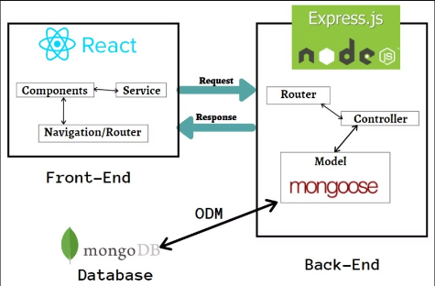
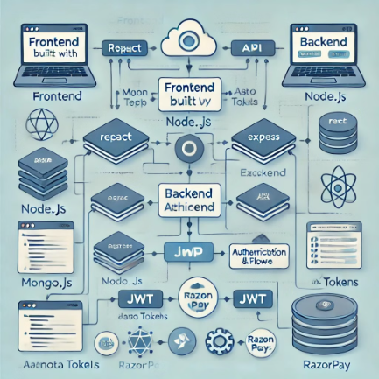
Architecture
The frontend is built using React and React Router, ensuring a dynamic and responsive user interface. It communicates with the backend(Node.js and Express.js) via RESTful API calls and MongoDb is used as database .The user interface is clean and minimalistic, providing easy navigation across categories, products, and order tracking.

Slide 9
Modules
1. Frontend Modules
2. Backend Modules
3. Development Tools
React: For building the user interface and managing components.
Express.js: For creating the RESTful API and handling routes.
Nodemon: For automatically restarting the server during development.
React Router: For enabling navigation between different pages.
Mongoose: For database interaction and schema definition.
Concurrently: For running both frontend and backend servers simultaneously.
Redux Toolkit: For state management across the application.
Axios: For making HTTP requests to the backend.
JsonWebToken (JWT): For user authentication and secure token management.
Dotenv: For managing environment variables securely.
Razorpay: For payment gateway integration.

Slide 10
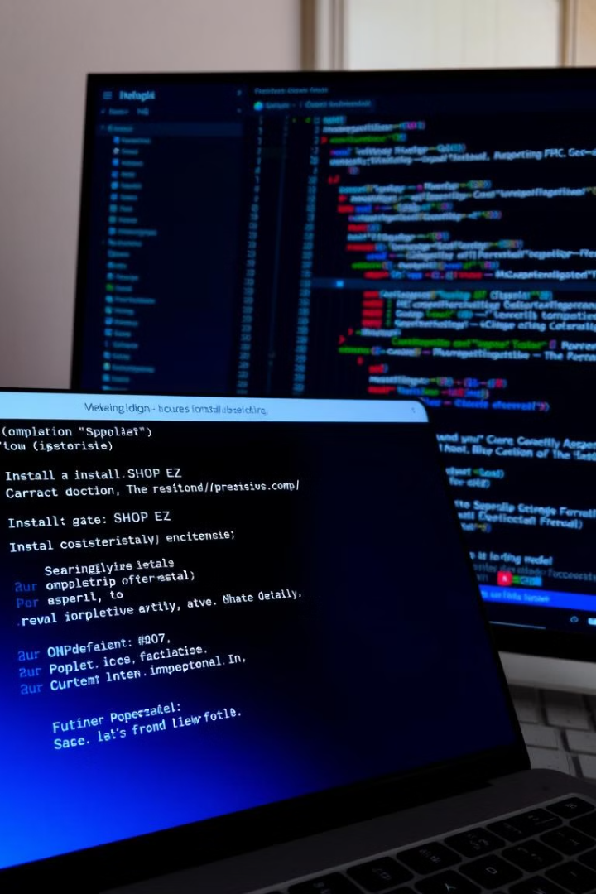

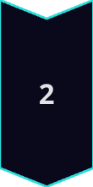


Setup Instructions
Prerequisites: Node.js (>= v14.x), MongoDB (running locally or via a cloud provider like MongoDB Atlas), npm (Node Package Manager).
Clone the Repository
git clone https://github.com/your-username/SHOP_EZ.git
Install Dependencies
Backend: cd backend + npm install
Frontend: cd frontend + npm install
Run Both Cocurrently : npm run dev
Set up Environment Variables
Create a .env file in the backend directory and include the following variables: MONGO_URI=your_mongodb_connection_string JWT_SECRET=your_jwt_secret PAYPAL_CLIENT_ID=your_paypal_client_id
Run the Application
Start Backend: npm run server
Start Frontend: npm run client

Slide 11
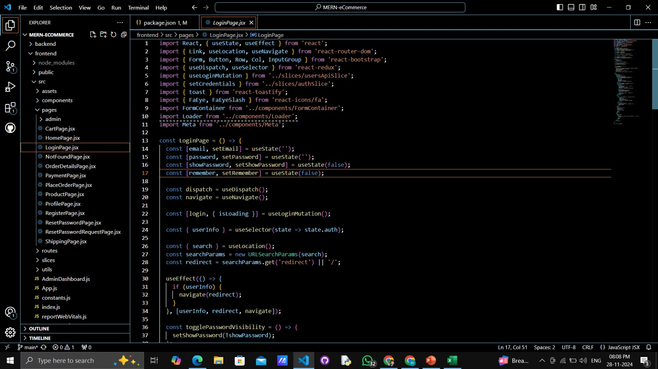
Sample Code

Slide 12
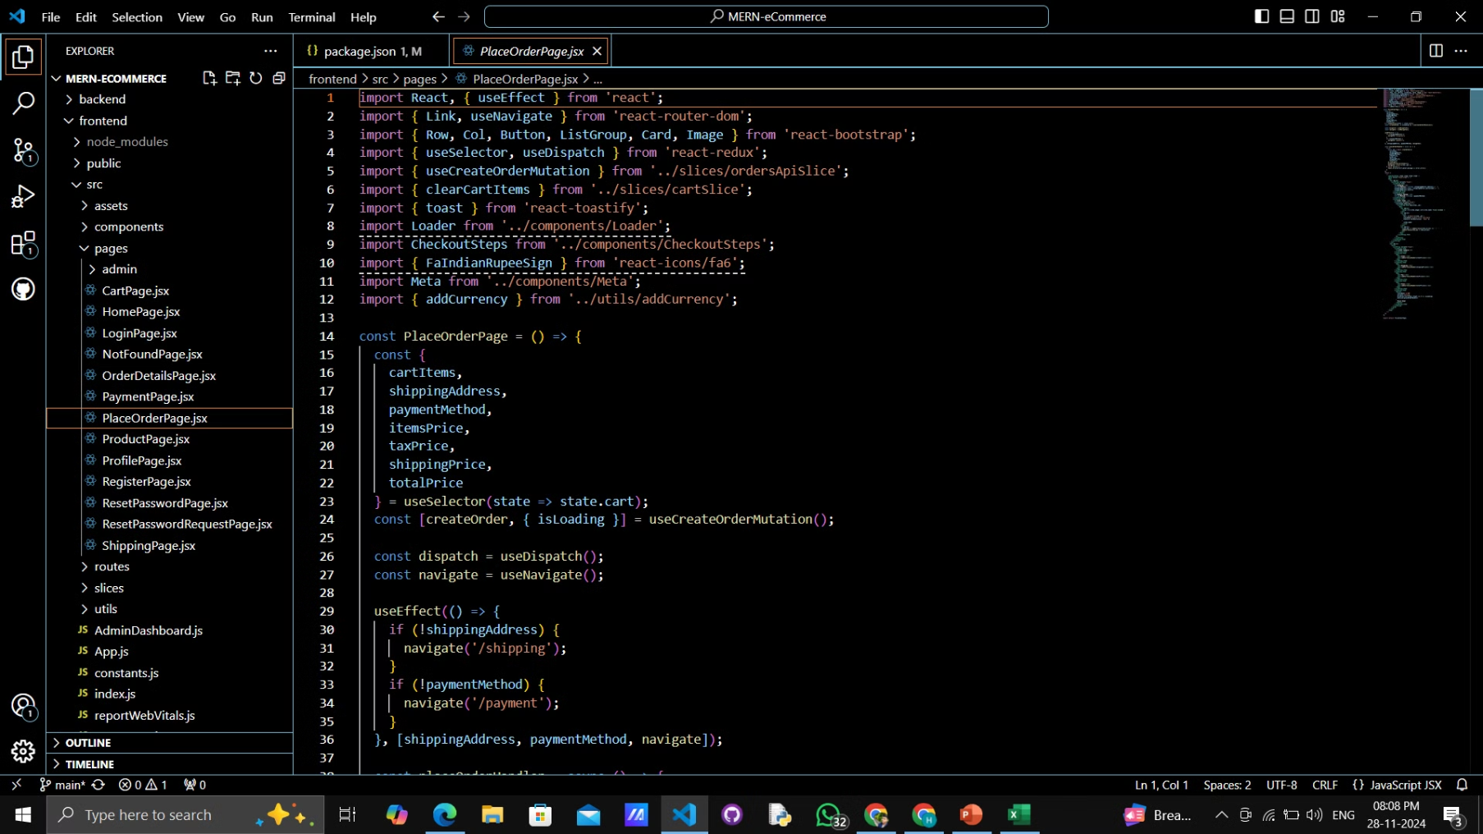

Slide 13
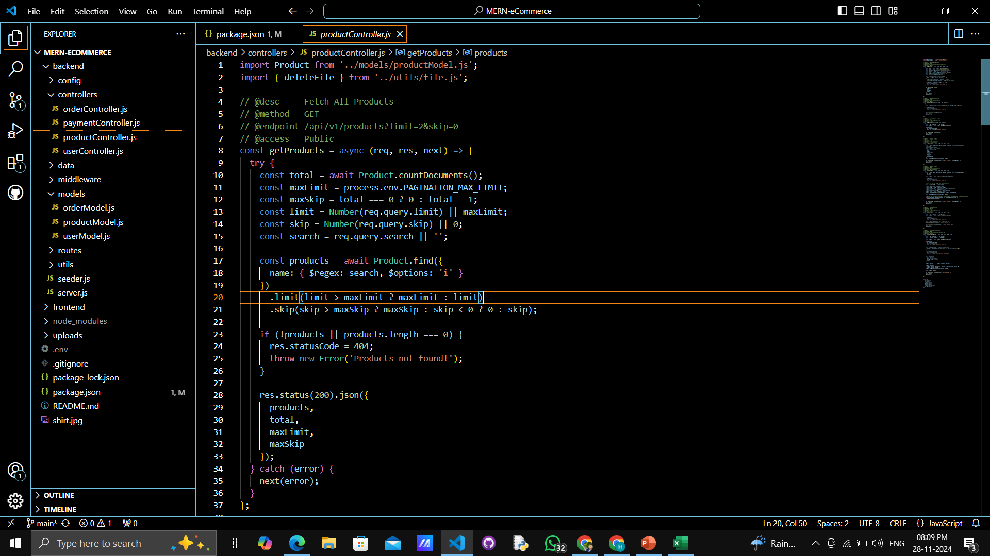

Slide 14
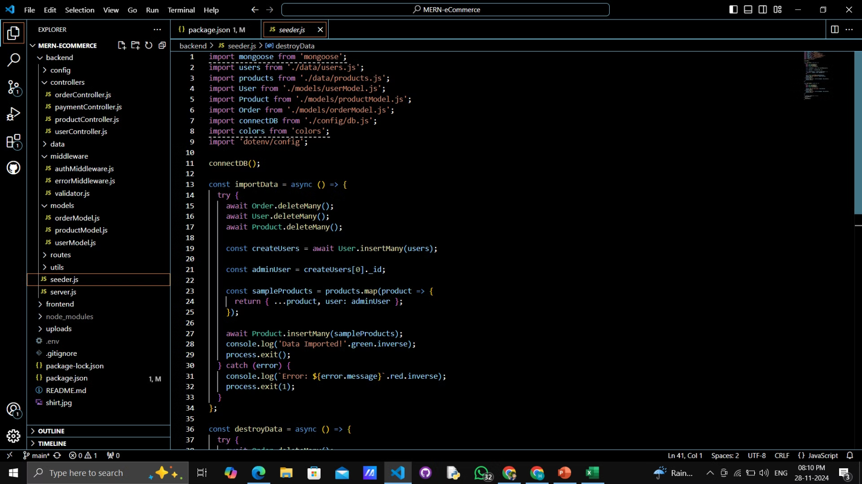
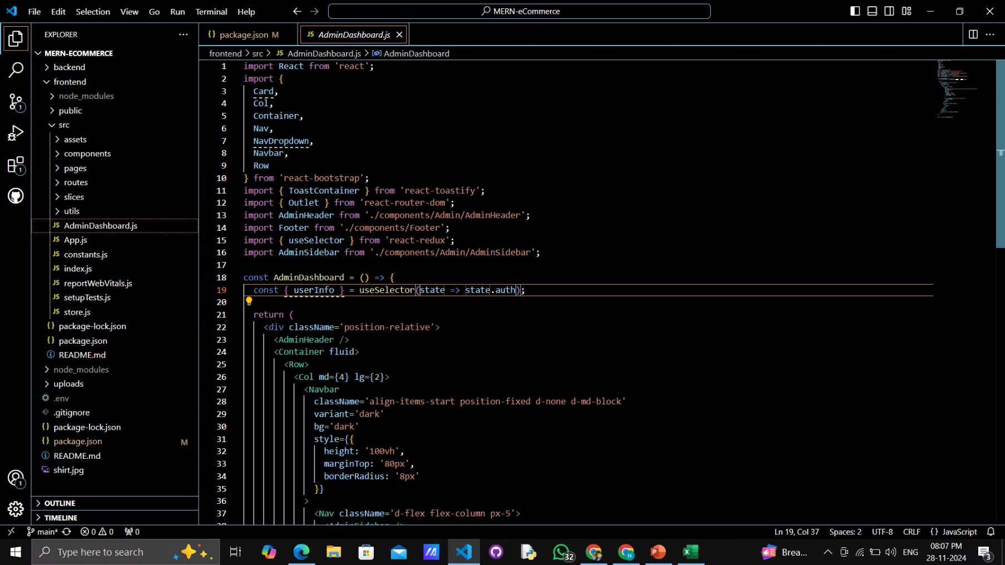

Slide 15
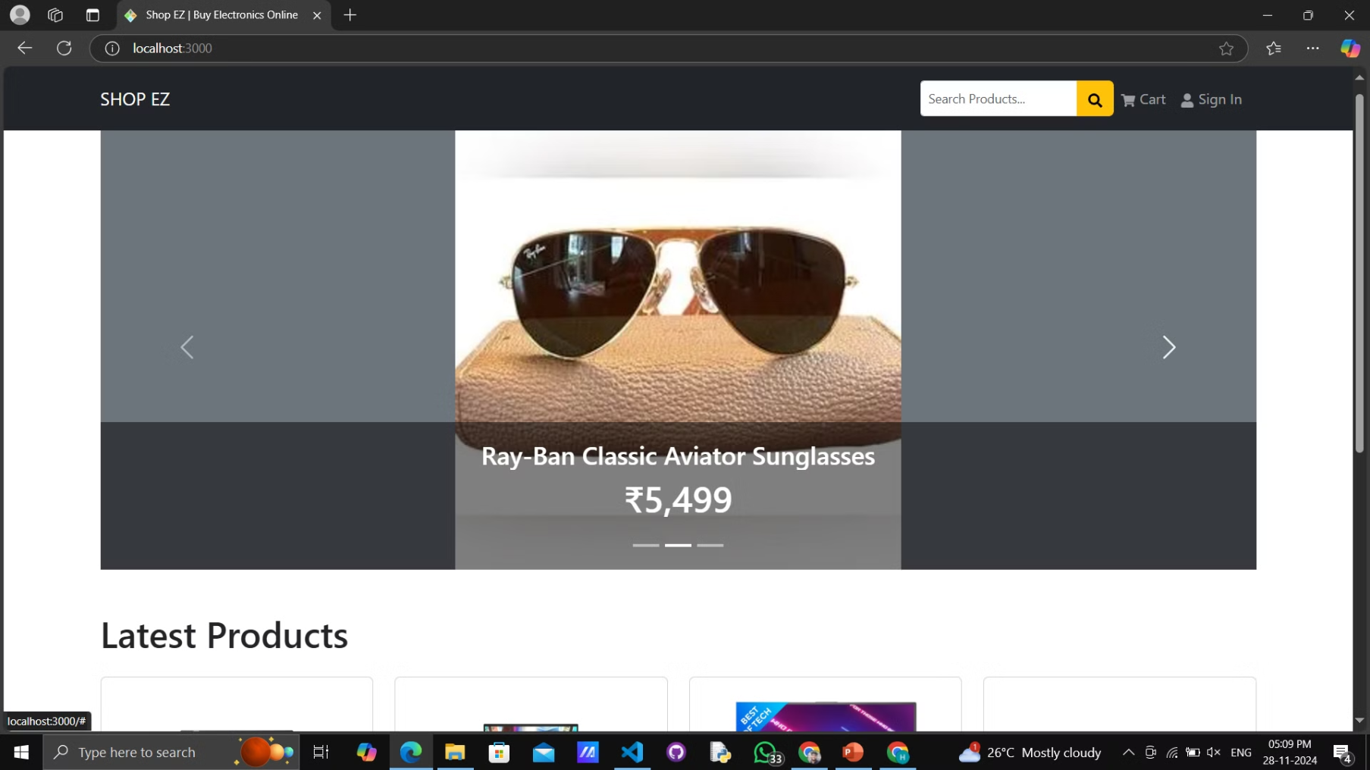
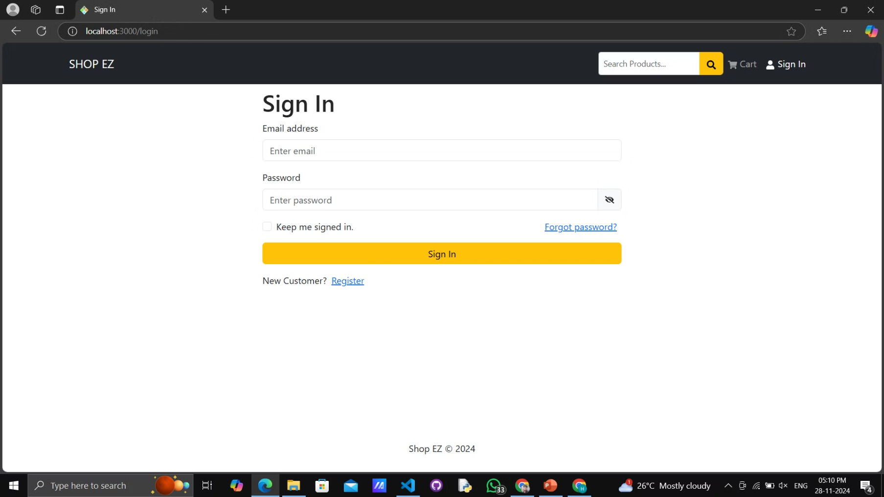
SCREENSHOTS

Slide 16
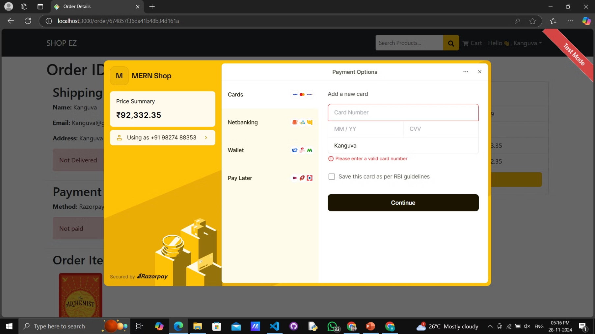
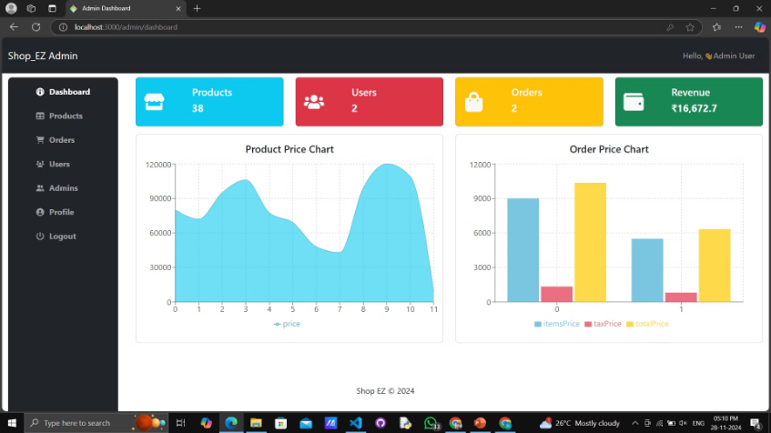
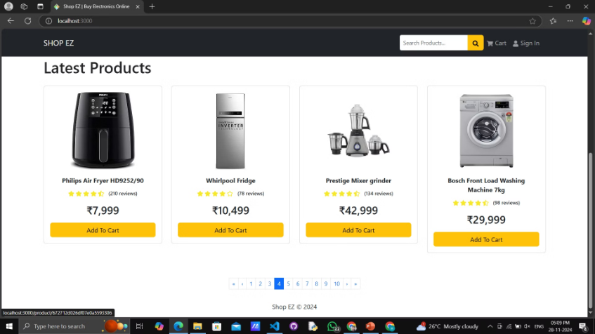
SCREENSHOTS

Slide 17
Conclusion
Key Takeaways
Successfully developed a fully functional eCommerce web application using the MERN stack.
Implemented essential features like user authentication, product management, shopping cart, and payment integration.
Ensured a responsive and user-friendly interface using React and Bootstrap.
Benefits of the Project
Streamlines the online shopping experience with a robust and scalable architecture.
Facilitates easy customization and future enhancements thanks to modular design principles.
Provides a secure platform with JWT authentication and encrypted user data storage.

Slide 18

Future Enhancements
Real-Time Features
Advanced Product Filters
Add chat support for customers to communicate with admins.
Expanding features like AI-driven product recommendations.
Implement more complex product filters based on ratings, price, and stock availability.
Multi-Currency Support
Admin Analytics
Enable multiple currencies for international customers.
Add sales data, product performance analysis, and inventory analytics for admins.
Optimizing performance for handling larger traffic and datasets.

Slide 19
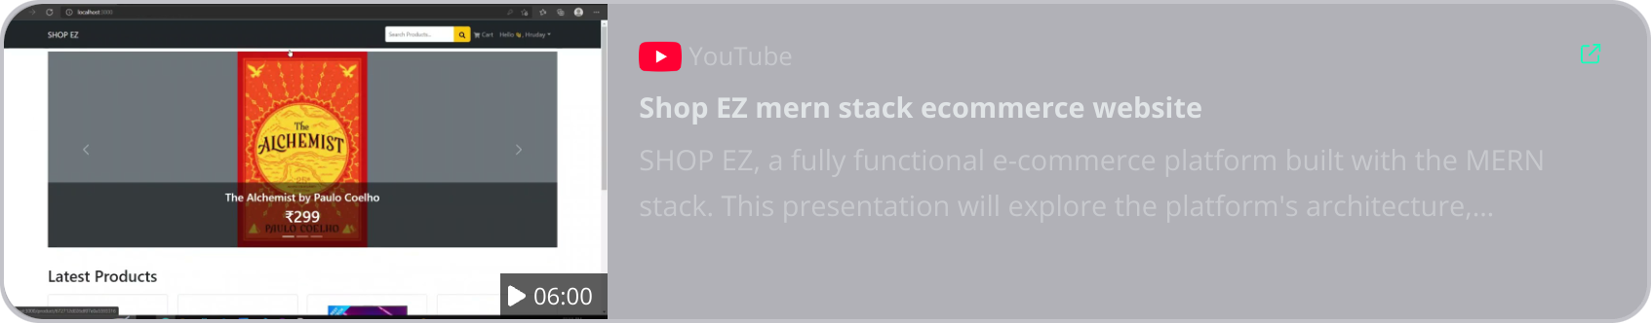
DEMO VIDEO

